Slide 1
Jeremiah 17:5-10
^{5 This is what the LORD says:}
"Cursed is the one who trusts in man,
who depends on flesh for his strength
and whose heart turns away from the LORD.
6 He will be like a bush in the wastelands;
he will not see prosperity when it comes.
He will dwell in the parched places of the desert,
in a salt land where no-one lives.
7 "But blessed is the man who trusts in the LORD,
^{whose confidence is in him.}

Slide 2
Jeremiah 17:5-10
8 He will be like a tree planted by the water
that sends out its roots by the stream.
It does not fear when heat comes;
^{its leaves are always green.}
It has no worries in a year of drought
and never fails to bear fruit."
9 The heart is deceitful above all things
^{and beyond cure.}
^{Who can understand it?}
10 "I the LORD search the heart
^{and examine the mind,}
to reward a man according to his conduct,
according to what his deeds deserve."

Slide 3
Looking Back – Living Forward
Lessons for today, learned from Old Testament Prophets

Slide 4
Looking Back – Living Forward
Lessons for today, learned from Old Testament Prophets
May 15th – Kirk Franklin
Jeremiah part 2

Slide 5
Review from part 1
Reconnect with God’s purpose for our lives:
Are we living fully in that purpose?
It’s never too late
God says stay close to Him:
Do we feel inadequate to fulfill God’s purpose for our lives?
Draw closer to God
Photo by Smart on Unsplash

Slide 6
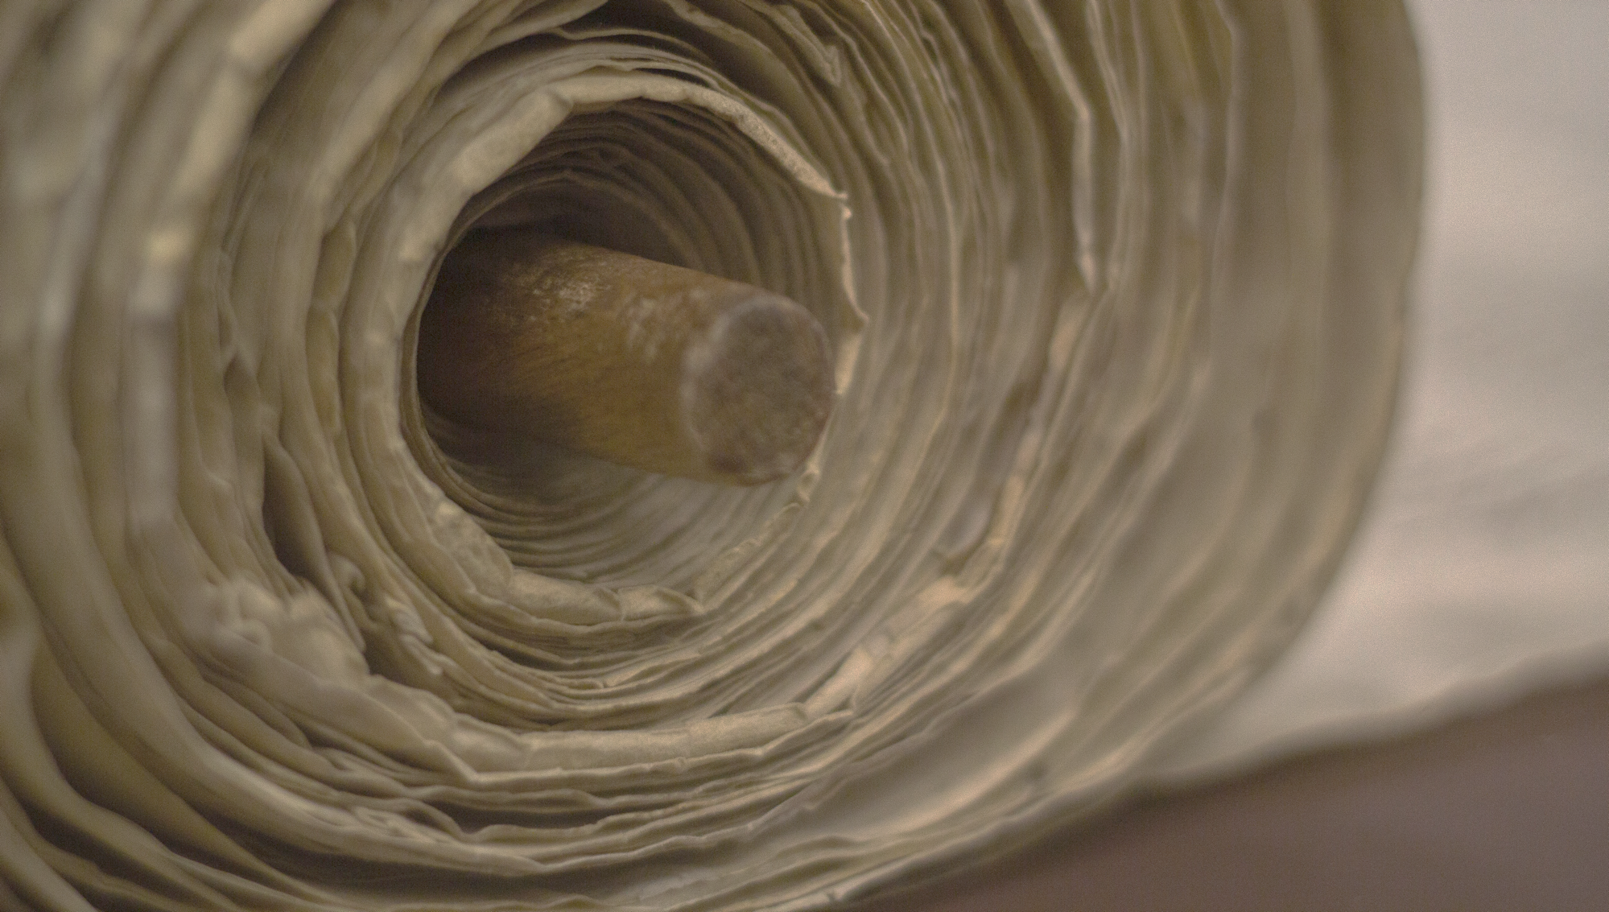
Interpretive approaches
God’s message to that day:
message of judgement
message of hope
God’s message about the future:
how the situation fits into His larger plan
Relevancy between past and present:
God’s concerns through Jeremiah reprimand and encourage us as well
Photo by Taylor Wilcox on Unsplash

Slide 7
Interpretive approach
YouVersion (app) vloggers share their 1.5-2 min videos about their favourite verses from Jeremiah
Photo by Josh Rose on Unsplash

Slide 8
Jer 17:7
But blessed are those who trust in the Lord
and have made the Lord their hope and confidence.
It’s easy to give in to fear
Loss of hope and happiness
We loose opportunities
Instead, live confidently
God has our backs
- Deryck Artero
Photo by Joe Woods on Unsplash

Slide 9
Jer 17:9-10
The human heart is the most deceitful of all things,
and desperately wicked.
Who really knows how bad it is?
But I, the Lord, search all hearts and examine secret motives.
I give all people their due rewards,
according to what their actions deserve.
Our hearts are deceitful
God knows our hearts
Desires of our hearts are for our good deeds
How’s your heart?
What flows from your heart?
- Toni Collier
Photo by Joe Woods on Unsplash

Slide 10
Jer 17:10
But I, the Lord, search all hearts
and examine secret motives.
I give all people their due rewards,
according to what their actions deserve.
God examines our thoughts
He’ll reward us according to our ways and deeds
Model God’s character
The intentions in our heart matter
Go forth and honour God!
- Toni Collier
Photo by Joe Woods on Unsplash

Slide 11
Jer 17:11
For I know the plans I have for you,” says the Lord. “They are plans for good and not for disaster, to give you a future and a hope…”
Life can make us battle weary
Can make us reluctant to plan…
God has good things planned
Nothing can change that
Begin to believe again
- Rachel G. Scott
Photo by Joe Woods on Unsplash

Slide 12
Jer 29:13
‘If you look for me wholeheartedly, you will find me….’
God is not hiding but waiting
Your history doesn’t disqualify you
Don’t get distracted
If you’ve stepped back, step in
Wholeheartedly seek God
You will find Him
- Christine Caine
Photo by Joe Woods on Unsplash

Slide 13
Jer 29:13
If you look for me wholeheartedly, you will find me….
It’s easy to feel in adequate in our relationship with God
God has access to all of who we are
Seek God with every part of who we are
- Jo Saxton
Photo by Joe Woods on Unsplash

Slide 14
Jer 31:3
Long ago the Lord said to Israel:
‘I have loved you, my people, with an everlasting love.
With unfailing love I have drawn you to myself.’
Are you going through struggles?
Realize God is your only hope
He’s the only one who truly loves you
God is out looking for you
God’s been looking for you all along
- Ronnie Brumley
Photo by Joe Woods on Unsplash

Slide 15
Jer 31:25
For I have given rest to the weary and joy to the sorrowing
God refreshes the weary
Give your burdens and anxieties to God
God intervenes and it makes a difference
Tell God about your struggles
Wait and listen for what He tells you
God will refreshen and strengthen you
- Nicky and Sila Lee
Photo by Joe Woods on Unsplash

Slide 16
Jer 31:25
…For I have given rest to the weary and joy to the sorrowing
Fatigue, overwork, burning out…
The edge of hopelessness
God speaks from a place of hope
God’s promises stand test of time
Hopeless doesn’t define tomorrow
God refreshes and satisfies the faint
- Jenni Wong Clayville
Photo by Joe Woods on Unsplash

Slide 17
Summary of YouVersion vlogger’s texts
Jer 17:7, 9-10 (x2) | Jer 29:11, 13 (x2) | Jer 31:3, 25 (x2)
But blessed are those who trust in the Lord and have made the Lord their hope and confidence. (v7) The human heart is the most deceitful of all things, and desperately wicked. Who really knows how bad it is? But I, the Lord, search all hearts and examine secret motives. I give all people their due rewards, according to what their actions deserve. (v9-10) | For I know the plans I have for you, says the Lord. They are plans for good and not for disaster, to give you a future and a hope…. (v11) If you look for me wholeheartedly, you will find me…. (v13) | Long ago the Lord said to Israel: I have loved you, my people, with an everlasting love. With unfailing love I have drawn you to myself. (v3) For I have given rest to the weary and joy to the sorrowing. (v25)
Jer 17: God lays out Judah’s sin: their worship of pagan idols. Therefore, Judah faces punishment as exiles at the hands of its enemies | Jer 29: A letter sent to the people who had been deported because of their disobedience to remind them of God’s purposes for them even in exile | Jer 31: God’s message of hope and restoration when he brings his people back from captivity. and they will ‘live together in peace and happiness’ (v24)

Slide 18
The ‘weeping prophet’
Jer 13:17
…if you still refuse to listen, I will weep alone because of your pride.
My eyes will overflow with tears, because the Lord’s flock will be led away into exile
Jeremiah’s prophetic warnings were mostly ignored
He responded with sorrowful tears of mourning
Photo by Tom Pumford on Unsplash

Slide 19
What we learn from Jeremiah
In Jeremiah we see that the excellence comes from a life of faith, from being more interested in God than in self, and has almost nothing to do with comfort or esteem or achievement
- Eugene Peterson
Although it has been 2,500 years since the Lord cried out to a rebellious generation through Jeremiah, the ancient paths remain the clearest solution to the crisis of our day
- Jenny Oliphant
Photo by Mona Eendra on Unsplash

Slide 20
Lamentations
Lamentations 3:22-24
The faithful love of the Lord never ends! His mercies never cease.
Great is his faithfulness; his mercies begin afresh each morning.
I say to myself, “The Lord is my inheritance; therefore, I will hope in him!”
Tone of Lamentations:
Suffering and misfortune happen
Their cause is sought and found
A contented future is foreseen
After repentance and a return to God
Photo by Joshua Woroniecki on Unsplash

Slide 21
Our Challenge
Deliberately choose to lift your eyes up from your current circumstances
Turn to the Lord who will meet you because His mercy has never failed through all eternity
Daily expect God’s faithfulness and kindness—His mercy
Photo by Artem Kovalev on Unsplash

